Slide 1
B-Bay
Website auction online

Slide 2
TEAM
Tạ Việt Hùng
Phạm Hà Hoàng Nam
Nguyễn Song Toàn
Nguyễn Anh Quân

Slide 3
DESCRIPTION
Website auction online
Helps organizations and individuals exchange and trade quickly and conveniently through auctions online.

Slide 4
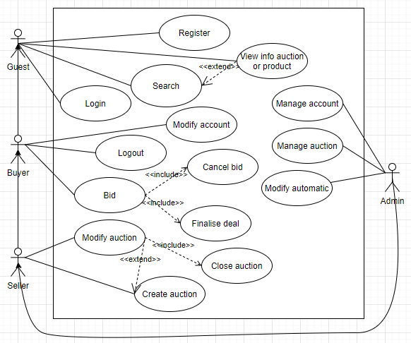

Slide 5
NON-FUNCTIONAL
The system ensures 24/7 operation
Security
All data input and output screens are displayed for 5s
Server condition accommodating more than 1000 users
Edit and upgrade up to 1 time within 3 months

Slide 6
Thanks for watching

